Slide 1
Application Security Cost Management
Presenter: Ketan Vyas
Date: 17th February 2012
Disclaimer: The views or opinions expressed on slides or discussed during this session are speaker’s alone and do not reflect the positions or opinions of employer or it’s affiliates. This presentation is based on speaker’s current knowledge on subject and personal experience. Please verify it independently before making decision based on it. In addition, any views or opinions expressed by audience during session are theirs and do not necessarily reflect speaker’s.

Slide 2
Agenda
Background
Application Security Budget
Suggestions to Improve Investment
Q & A

Slide 3
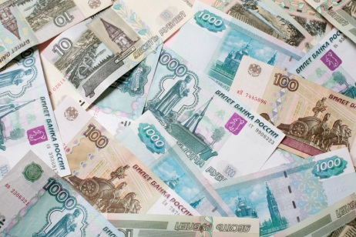
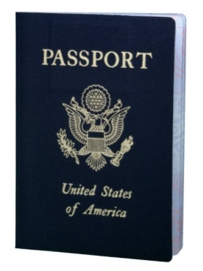

Security is still sold NOT bought
Personal Data
Finance Data
Trade Secrets
National Data

Slide 4
Compliance and Security
What comes first?

Slide 5

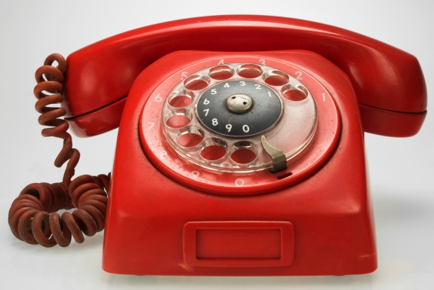
Security and Convenience
can go hand-in-hand in most cases
if budgetary equation set correctly

Slide 6
Smart Solution needs Smarter Security
Japan scientist makes first ‘Avatar’ robot

Slide 7
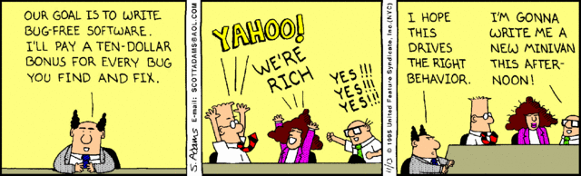
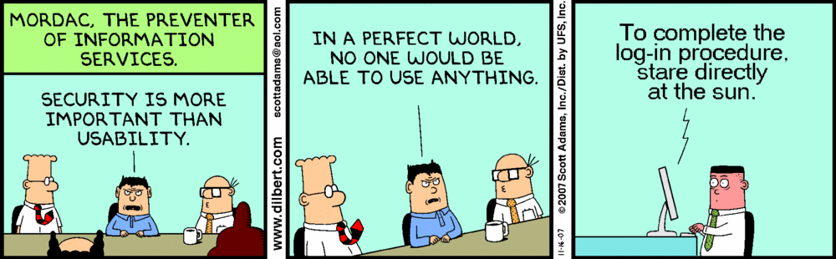
Developer – The Weakest Link

Slide 8
Application Security Expectations
Outsourcers
Need 100% security
Operators
We run tools
Developers
Security is
additional scope
Security Service Providers
You are insecure without us

Slide 9
"Does Application Security Pay? Measuring the Business Impact of Software Security Assurance Solutions", whitepaper by Mainstay Partners LLC
Application security pays, but at what cost?

Slide 10
Agenda
Background
Application Security Budget
Suggestions to Improve Investment
Q & A

Slide 11
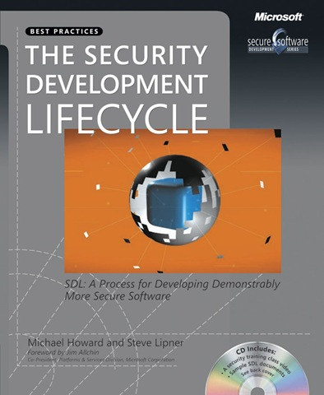

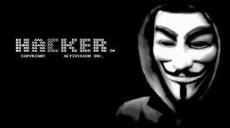
App security Rat Race Fueled by Incidents

Slide 12
Cost v/s Investment
Meaningless debate if you do not have mature app security process

Slide 13
Whose Budget Drives App Security?
Risk, Compliance & Delivery
CIO
CSO
CTO
Projects
Application Security

Slide 14
Who Actually Utilize Appsec Budget?
Compliance team
Infrastructure security team
Infrastructure team
Physical security team
Development team
Application Security team ??? – There is no such team

Slide 15
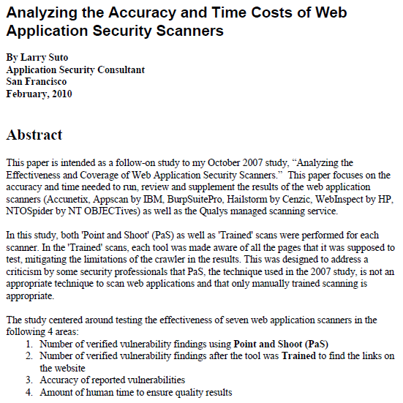
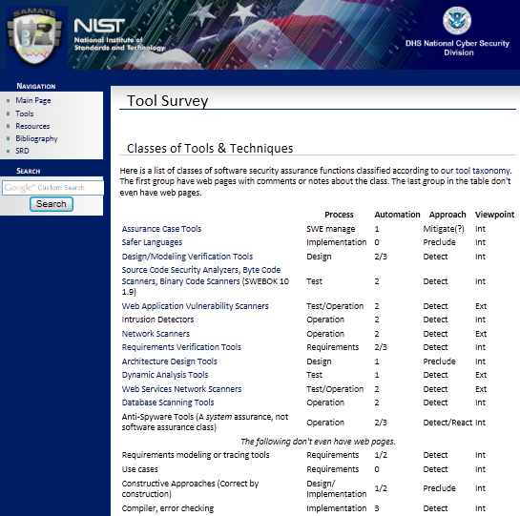
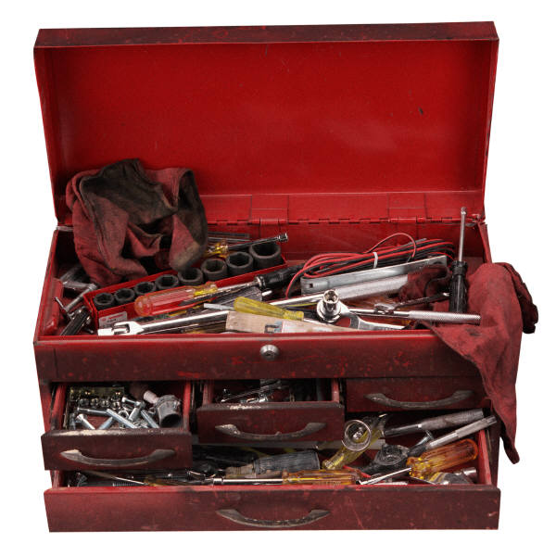
Which Security Tool is a Silver Bullet?
99.99 v/s 99.9999, each additional 9 costs a lot

Slide 16
Agenda
Background
Application Security Budget
Suggestions to Improve Investment
Q & A

Slide 17

Increase Adoption Rate
By showing proper business case to decision makers
Using Evangelists
Building and sharing success story
Retaining skilled resources
Mandating security signoff

Slide 18
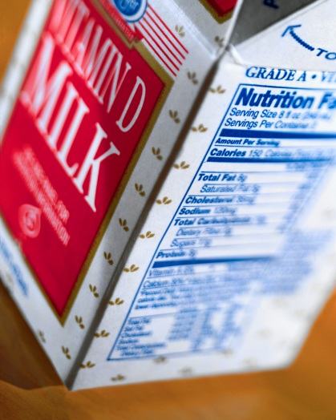
Assurance requirements for products and services are different
Understand scope and reduce effort overlap

Slide 19
Use Proven Free/Open source library
OWASP ESAPI (Source: BSD license, documentation: Creative Commons license)
Microsoft AntiXSS (Microsoft Public License)
Bouncy Castle (MIT X11 License)
ModSecurity (Apache Software License v2)
OpenSSL, PhpSec, OWASP AntiSamy & AppSensor and so on.

Slide 20

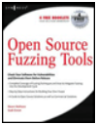




Try open source / freeware Tools

Slide 21
Role based Training
Free
Online webinars
Tool training from vendors
Expert lectures
Paid
Conferences like NullCon, blackhat
Workshops (Corporate, Professional services)
Free Training Material
OWASP Tutorial Videos
Microsoft SDL videos and presentations
SecurityTube.net
Webgoat type applications
Security conference presentations / video
OWASP Podcast, Cigital silver-bullet podcast

Slide 22
Educate Application Architects and Infrastructure Security Managers on Application Security

Slide 23

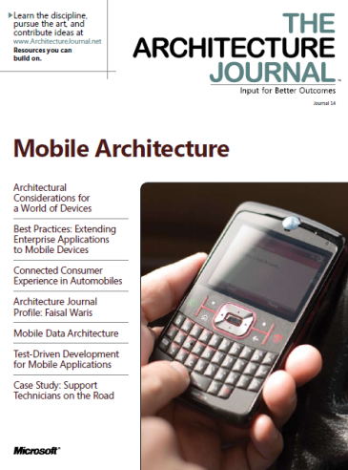
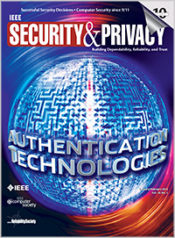
Learning from Selective Online Sources
OWASP RSS Feed, seclist
Blogs: Microsoft SDL, Whitehatsec, Veracode, Bruce Schneier and so on

Slide 24
Incentives & Reward Programs

Slide 25

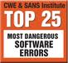

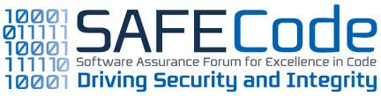
Benchmark against Best Practices
OWASP SAMM
BSIMM3

Slide 26
Fault Tolerant Development
Create “Role → Functionality → Data” matrix
Ensure code analyzed for quality best practices (i.e. against pmd rules) prior to check-in
Maintain centralized error repository and each error occurred during development & unit test shall be considered as a test case for next version
Threat model & Fuzz test all interfaces
Log and analyze each component behavior and memory footprint before integration
Deploy environment integrity controls and ensure suppliers also follow similar controls

Slide 27
Understand the Difference
Fault Removal
Fault Prevention
Source Code Security Analysis
Security Testing
VA/PT
Auditing Host
ACL & Configurations Review
Periodic Scans
Education
Security Requirements
Threat Model
Code Generation
Reuse
Periodic Audits & Reconciliation

Slide 28
Useful Resources
State of Application Security: Immature Practices Fuel Inefficiencies, but Positive ROI Is Attainable - A Forrester Consulting Thought Leadership Paper Commissioned by Microsoft, http://www.microsoft.com/download/en/details.aspx?id=2629
Does Application Security Pay? Measuring the Business Impact of Software Security Assurance Solutions, https://www.fortify.com/ssa-basics/why-ssa/roi_study_2010.html
The Microsoft SDL: Return on Investment, http://go.microsoft.com/?linkid=9696910
OWASP Projects, https://www.owasp.org/index.php/Category:OWASP_Project
OWASP Phoenix/Tools, https://www.owasp.org/index.php/Phoenix/Tools
SDL Developer Starter kit, http://www.microsoft.com/security/sdl/adopt/starterkit.aspx
Hacking Without All the Jailtime (list of vulnerable app for learning), http://ha.ckers.org/blog/20090406/hacking-without-all-the-jailtime/
CWE and related efforts, http://cwe.mitre.org/
Security Videos, www.securitytube.net

Slide 29
Thank you
Ketan Vyas (ketan.vyas@tcs.com)

